Slide 1
BREAST CANCER
Classification Using Neural Network
Machine Learning Project • Python • TensorFlow / Keras • Google Colab
Presented by Swapnali Sathe
Actual notebook code • actual outputs • actual training graphs
2026

Slide 2
Project Overview
02
DATASET
FEATURES
TRAINING
TESTING
569
30
455
114
records
input features
records
records
Goal
Build a Neural Network classification workflow that uses diagnostic measurements to classify tumor cases into Malignant or Benign categories.
Notebook workflow
Load data → Explore → Split → Standardize → Build model → Train → Evaluate → Predict

Slide 3
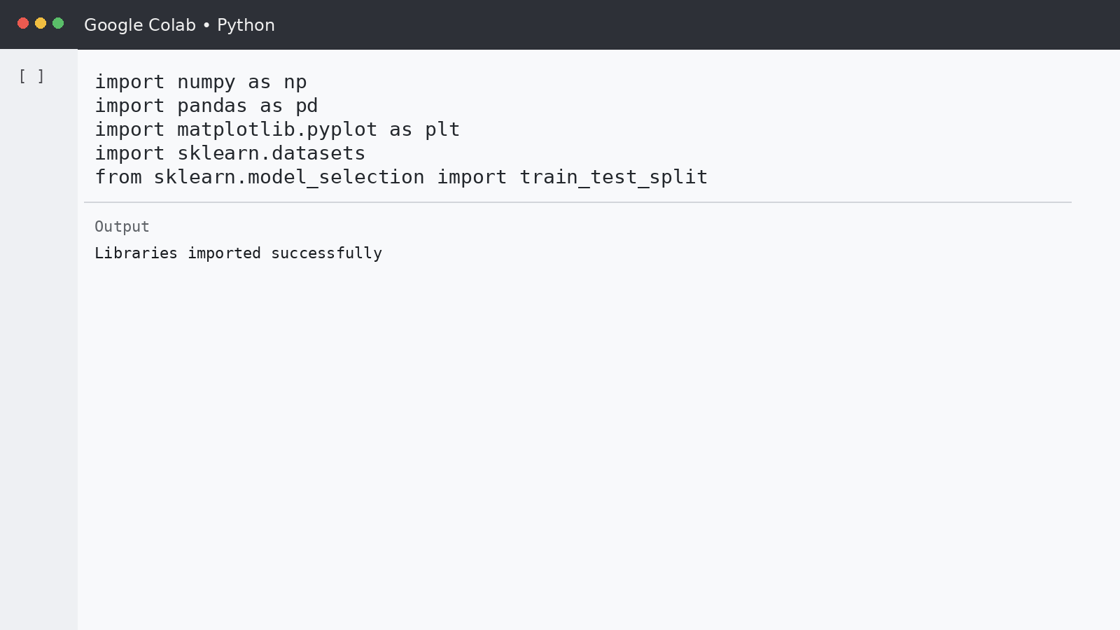
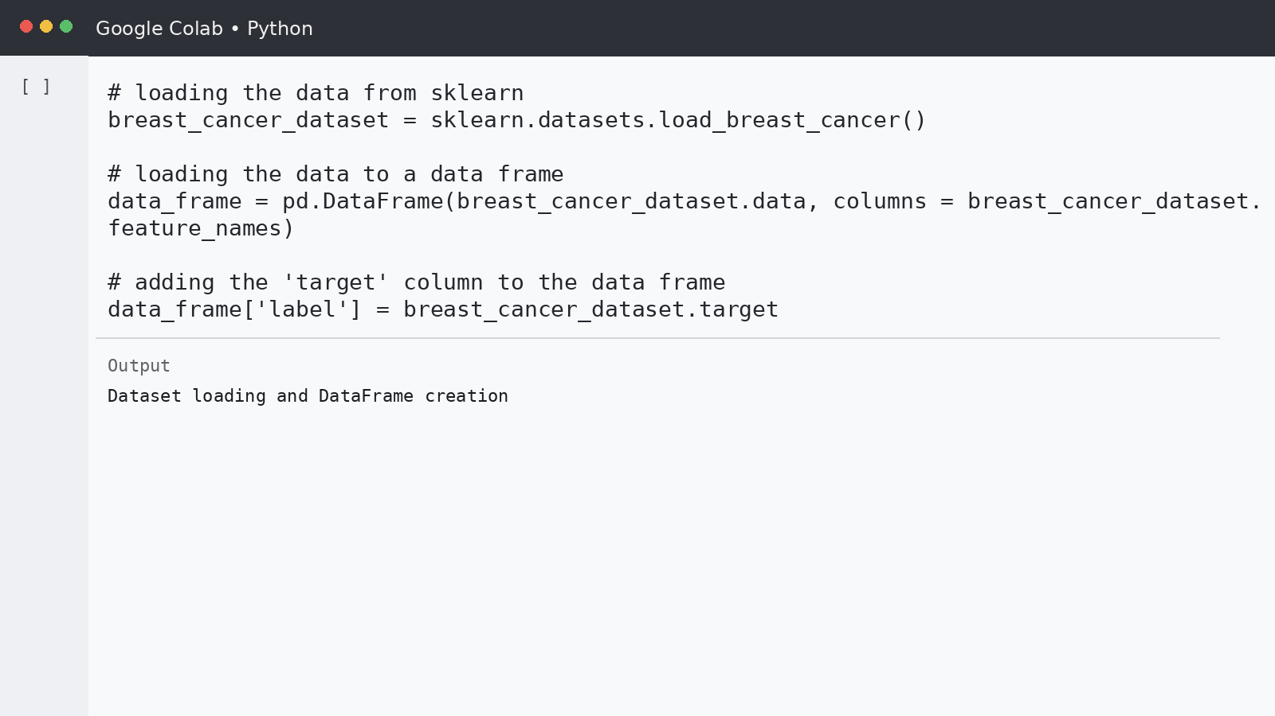
Actual Code — Import & Dataset
03
Exact imports from the notebook
Exact dataset/DataFrame code from the notebook

Slide 4
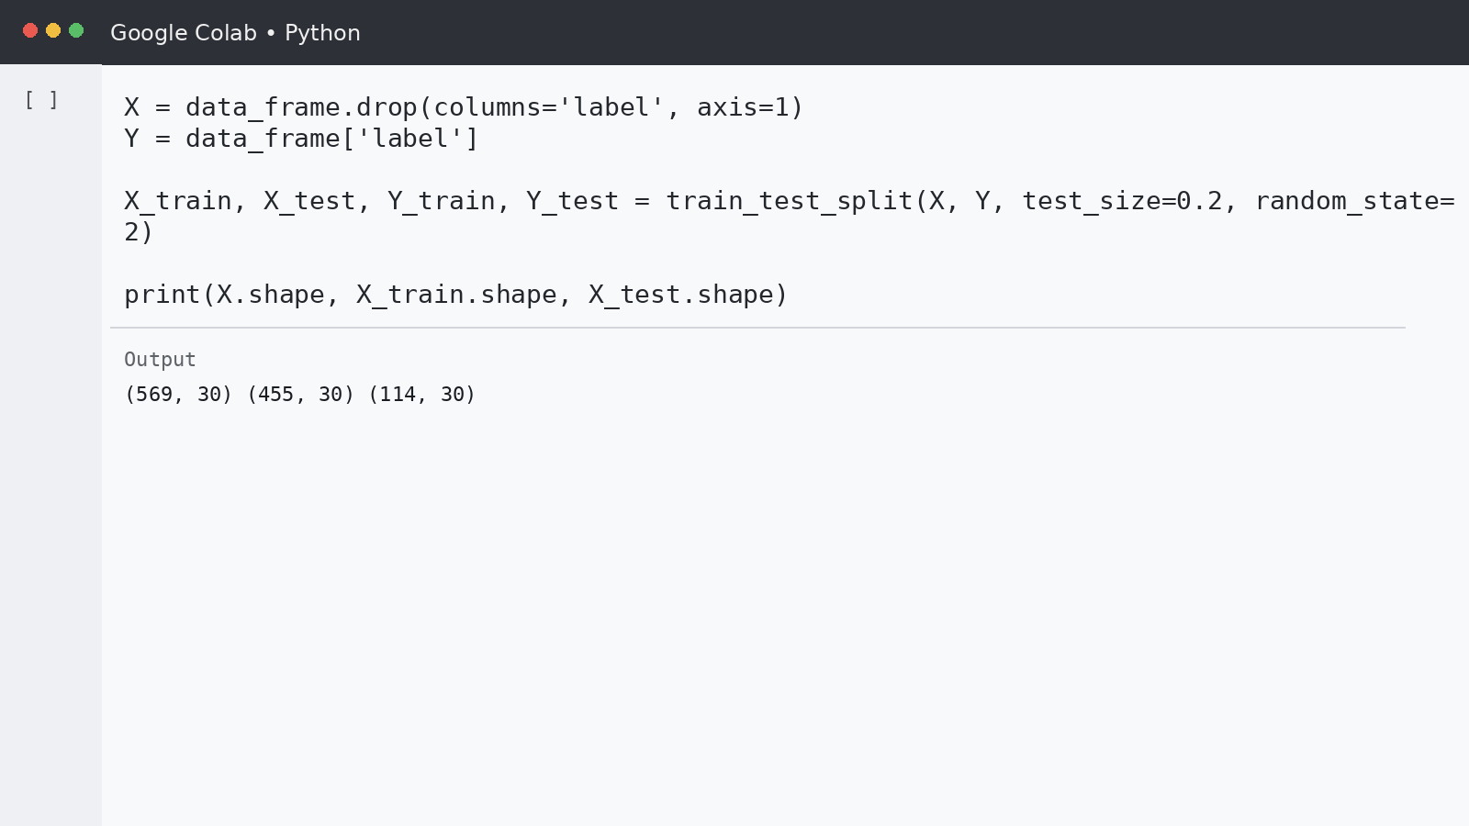
Dataset Exploration
04
Scikit-learn breast cancer dataset
569 records and 30 numerical features
31 DataFrame columns after adding the label
Missing-value check and descriptive statistics were executed in Colab
LABEL 0
LABEL 1
Malignant
Benign
target class
target class
DATA SPLIT
80:20
455 train / 114 test

Slide 5
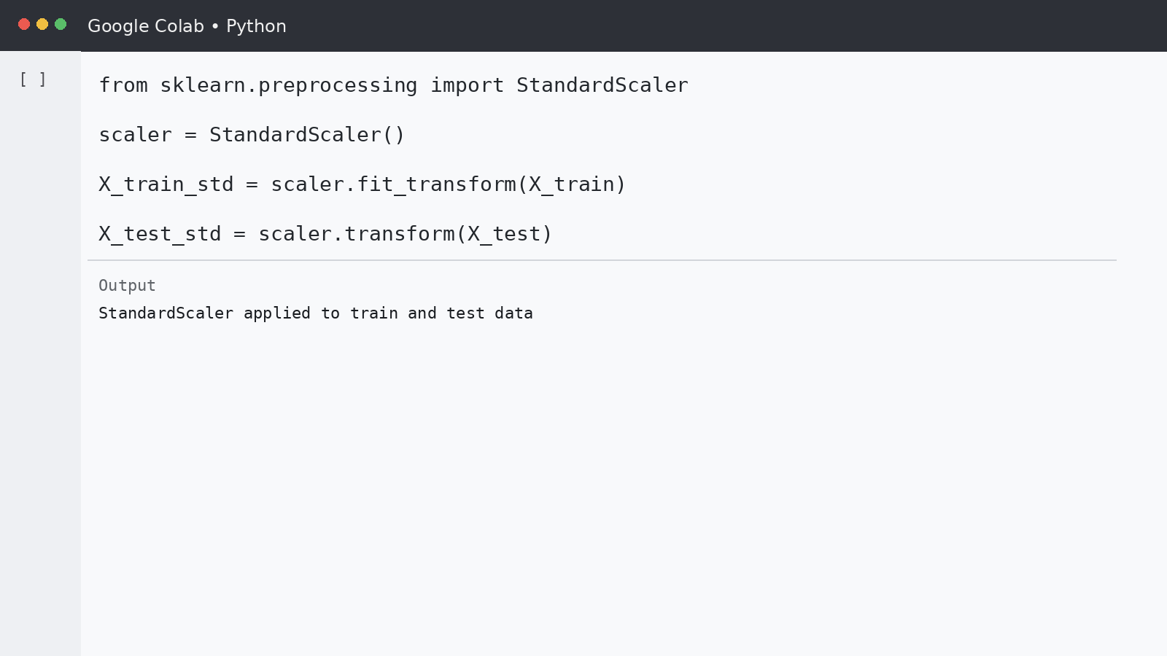
Train-Test Split & Standardization
05
Actual split output: (569, 30) (455, 30) (114, 30)
StandardScaler: fit on training data, transform test data

Slide 6
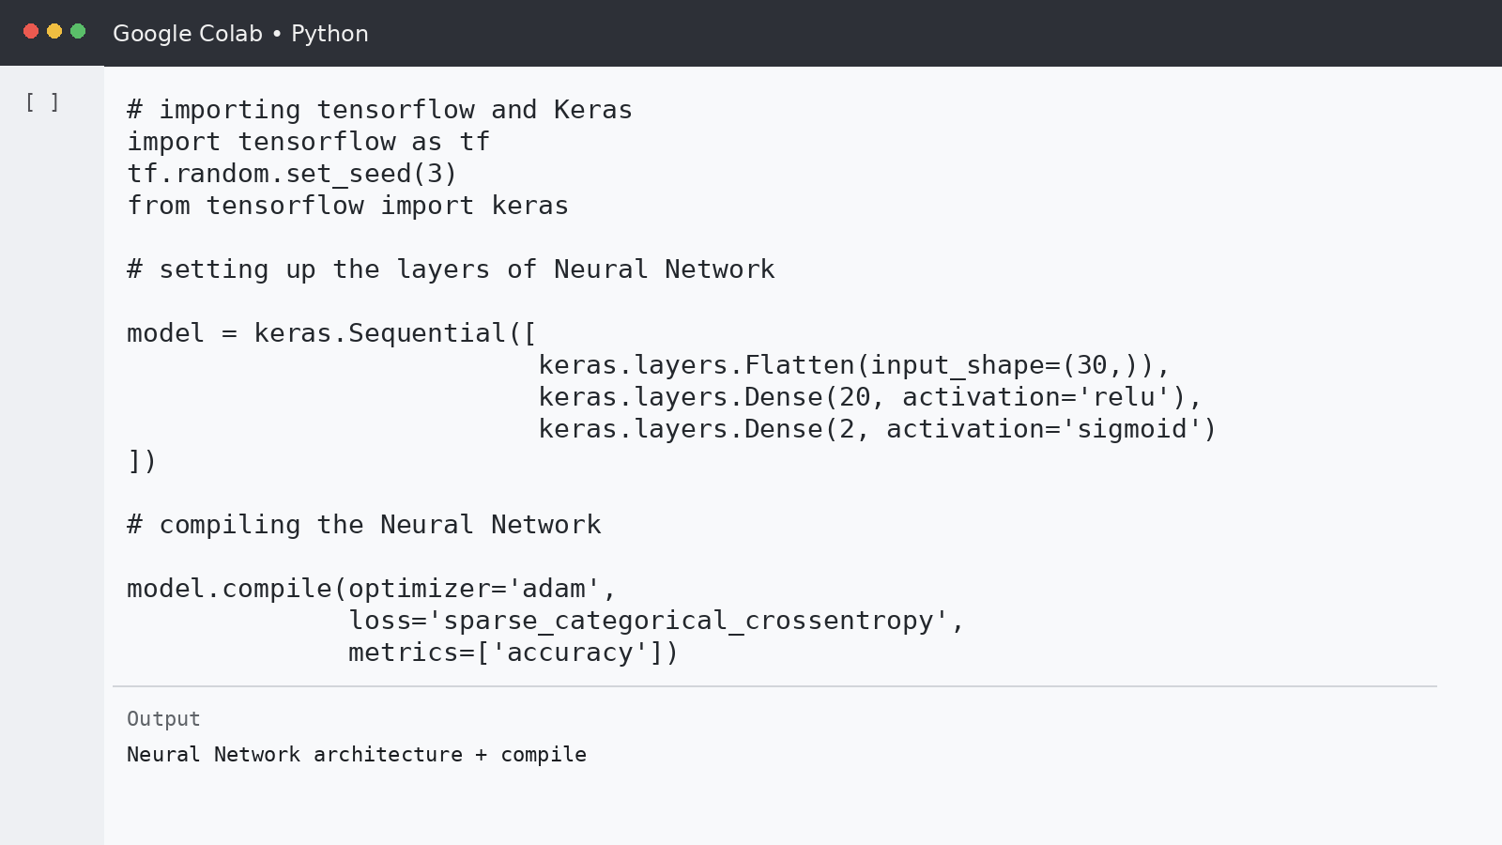
Neural Network — Actual Code
06
Architecture in the notebook: Flatten(30) → Dense(20, ReLU) → Dense(2, sigmoid) • Optimizer: Adam • Loss: sparse_categorical_crossentropy

Slide 7
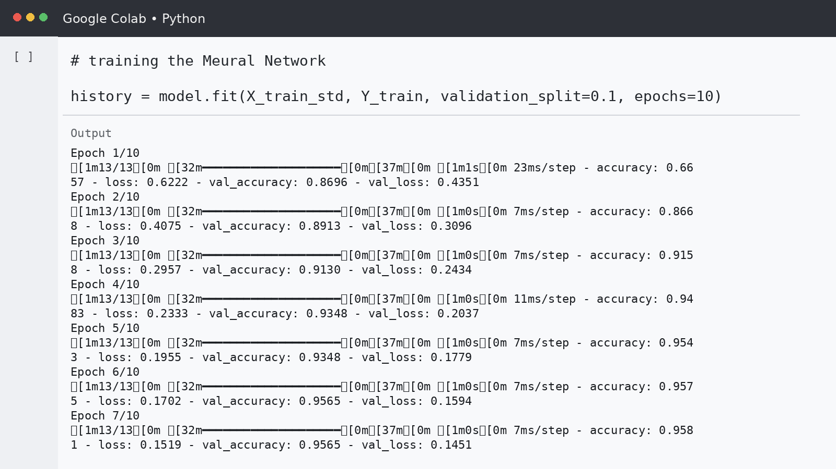
Actual Training Output
07
10 epochs • validation_split = 0.1 • output reproduced from the notebook training cell

Slide 8
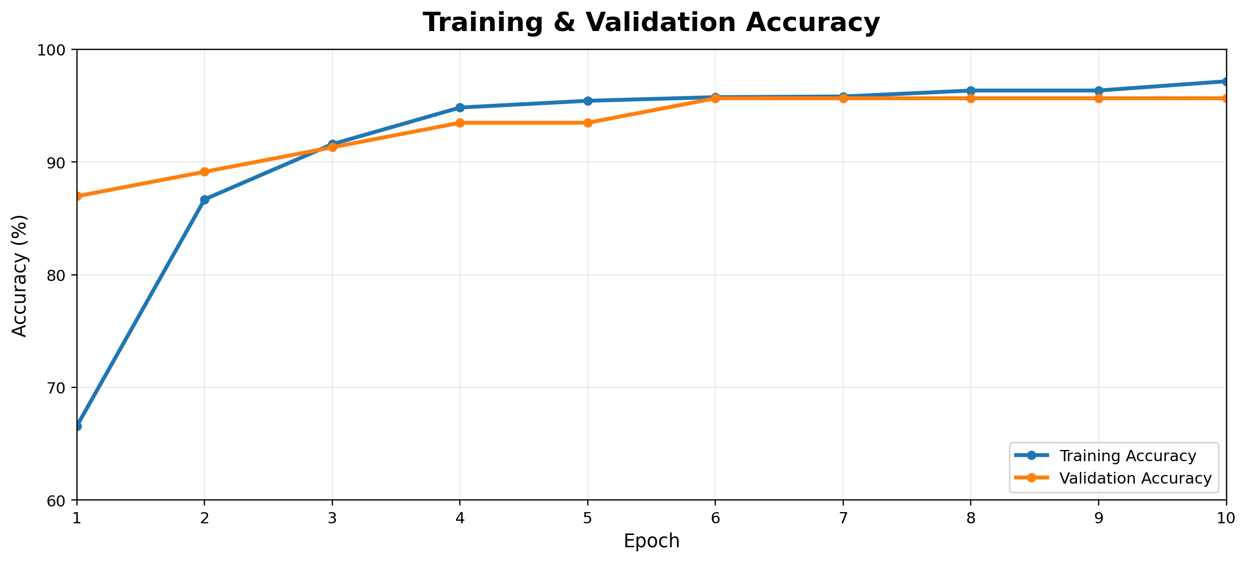
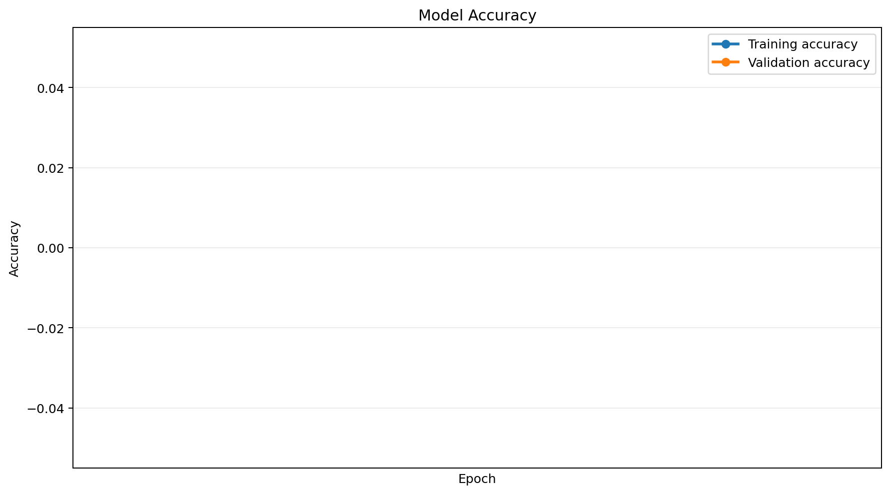
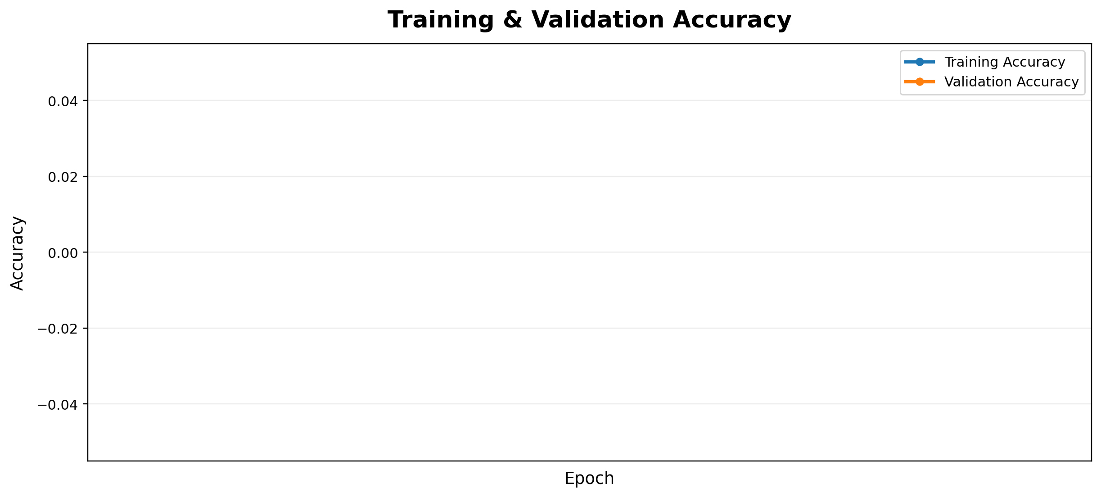
Training Accuracy — Actual Graph
08
Epoch 10 → Training Accuracy: 97.16% | Validation Accuracy: 95.65%

Slide 9
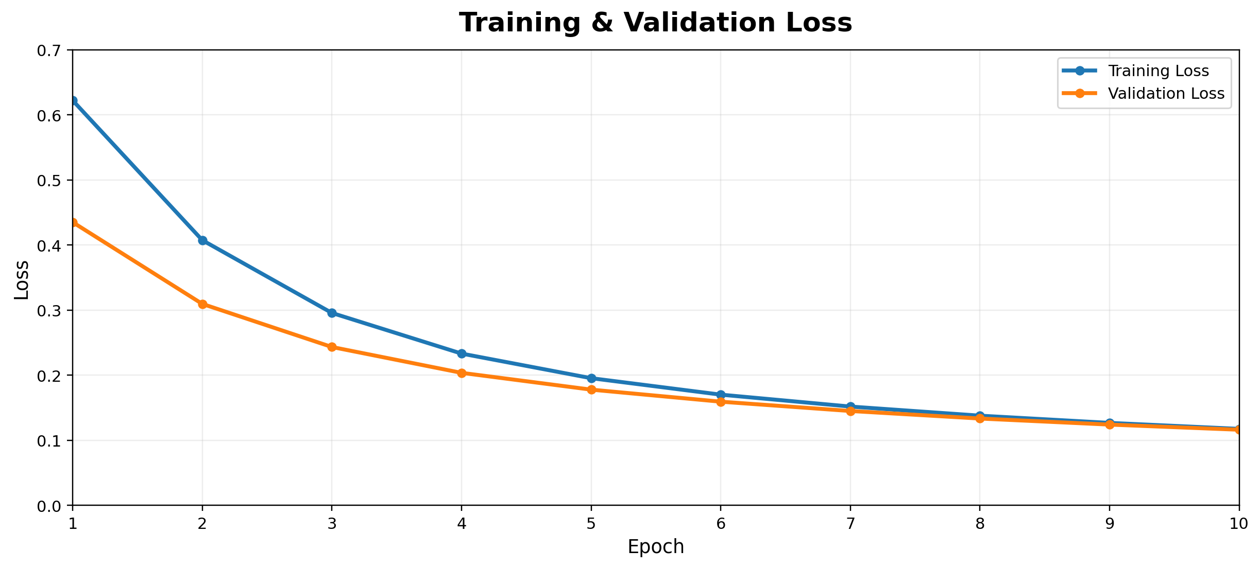
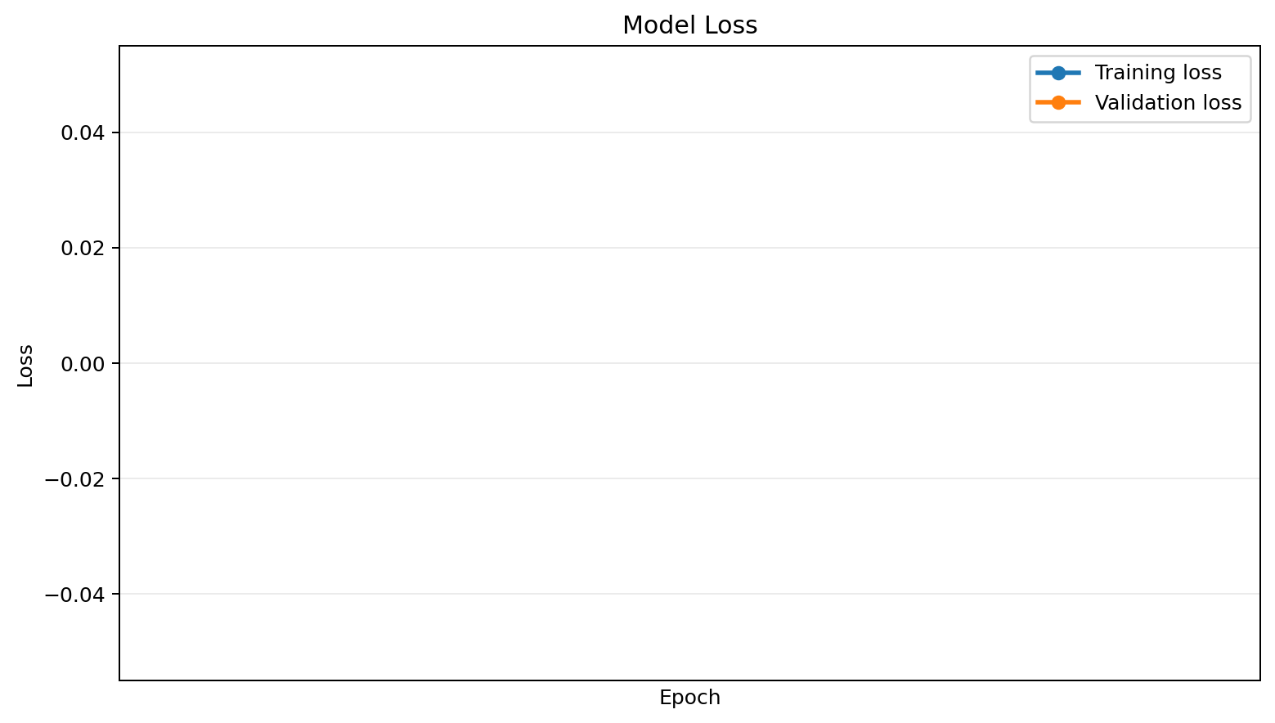
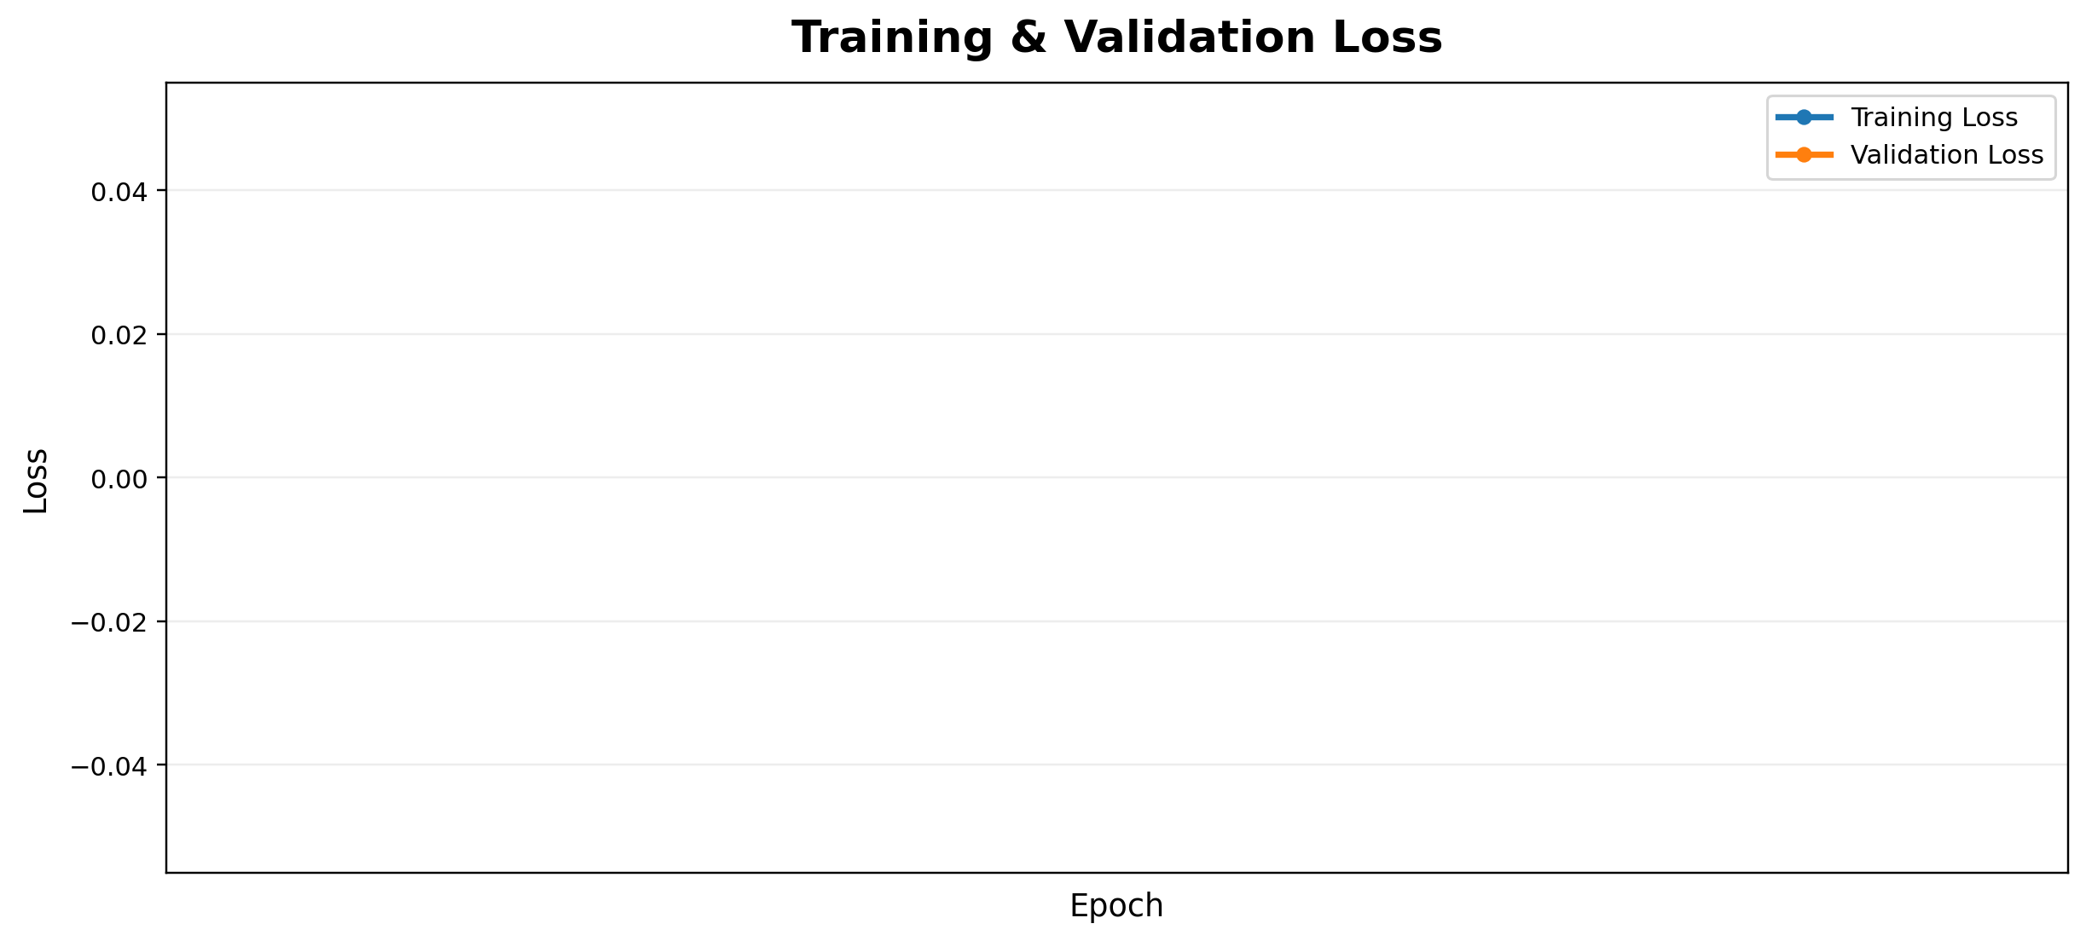
Training Loss — Actual Graph
09
Epoch 10 → Training Loss: 0.1176 | Validation Loss: 0.1163

Slide 10
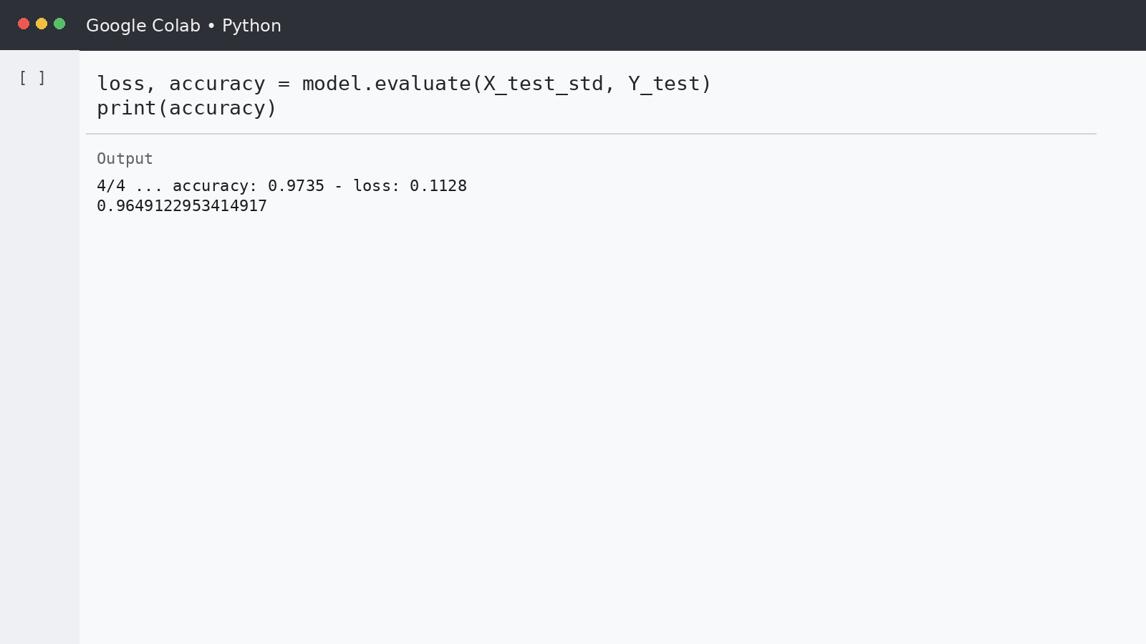
Model Evaluation — Actual Result
10
TEST ACCURACY
96.49%
0.9649122953414917
TEST RECORDS
114
held-out records
The evaluation output is directly from model.evaluate(X_test_std, Y_test).

Slide 11
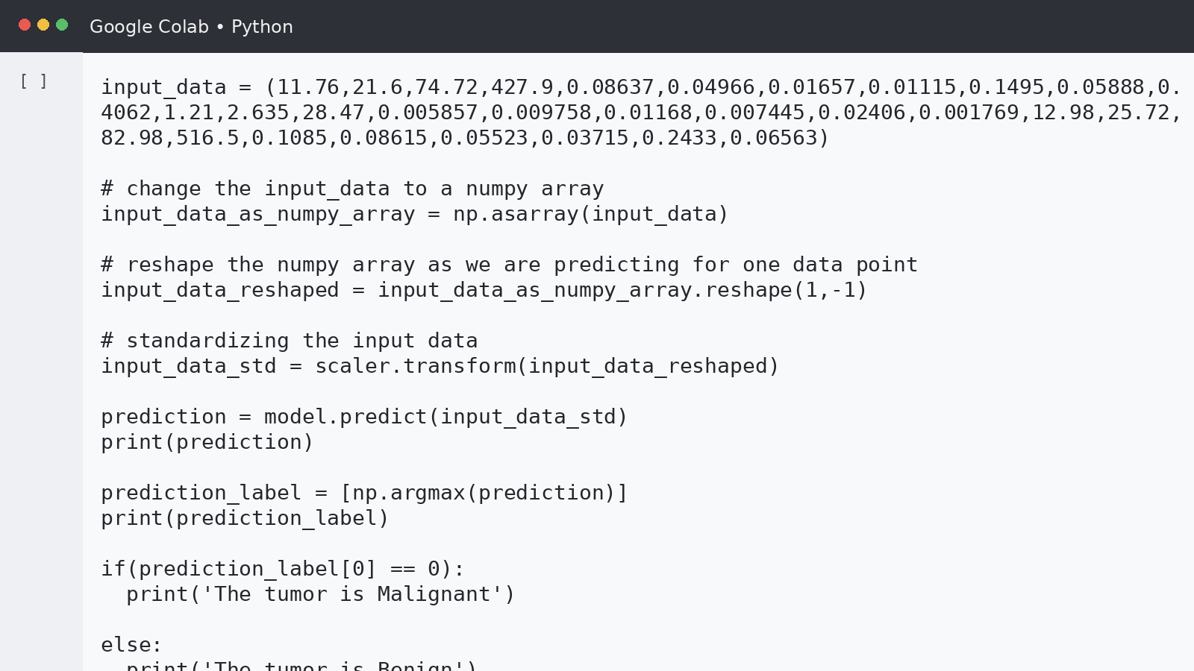
Prediction Probabilities — Actual Output
11
Sample prediction
CLASS PROBABILITIES
[0.0775, 0.9006]
from the notebook output
PREDICTED CLASS
1
argmax of probabilities
NOTEBOOK MESSAGE
Benign
sample input result

Slide 12
Prediction Workflow
12
01
02
03
04
05
30 feature values
StandardScaler
Neural Network
Class probability
Argmax → class label
This flow is implemented in the notebook's predictive-system section.
Input tuple → NumPy array → reshape to one record → standardize → model.predict() → np.argmax() → final class label

Slide 13
Results Summary
13
TRAINING ACCURACY
VALIDATION ACCURACY
TEST ACCURACY
97.16%
95.65%
96.49%
epoch 10
epoch 10
114 test records
Recorded project configuration
569 records • 30 input features
455 training records • 114 testing records
10 training epochs • validation split 10%
20-neuron hidden layer with ReLU • 2-output layer with sigmoid

Slide 14
Conclusion & Future Scope
14
What was completed
Possible next steps
Dataset loaded and converted into a DataFrame
Features and target separated
Train-test split and StandardScaler applied
Neural Network built and trained
Accuracy/loss visualized
Test evaluation and sample prediction completed
Hyperparameter tuning
Compare additional classification algorithms
Add confusion matrix and classification report
Create a simple prediction interface
Evaluate on additional datasets
Educational ML project — the model output should not be treated as a clinical diagnosis.
THANK YOU

